Slide 1

Help college of arts and technology
Diploma in Computer Science
Software Project
1st August 2016
Cavin Neoh
Jonathan Gan
Elden Ng
“James” Wong

Slide 2

The Diploma in computer science subjects semester study planner
The STUNNER

Slide 3
OBJECTIVES
-Generate a study plan that optimises subject enrolment
-Allow administrator to edit generated study plan
-Email study plan to students

Slide 4
PROBLEM statements
-Might delay completion of course (more than 7 semesters)
-Students unaware of course outline and pre-requisites
-Unable to enrol subjects without completing pre-requisites

Slide 5
Existing system’s Weakness
-Manually planned (Inconvenient)
-Plans for new students only
-Last updated in 2015

Slide 6
Here comes THE stunner!
-Advanced sorting algorithm to plan semesters
-Supports new students and existing/transfer students
-Enable editing of plan

Slide 7
Implementation
-Web application built on PHP, HTML, JavaScript
-Database access with MySQL, on Apache server
-Gmail SMTP server

Slide 8
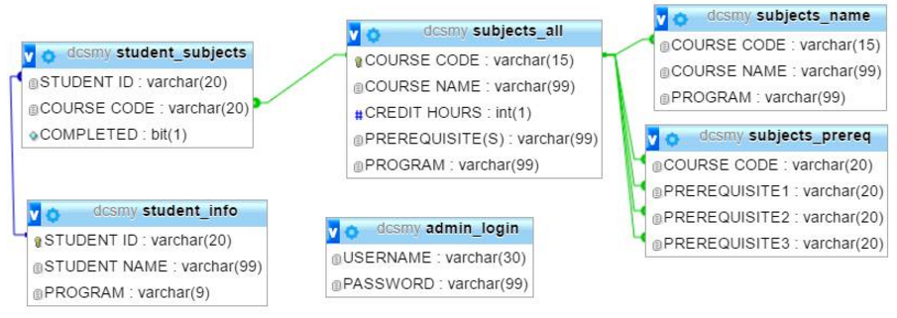
Entity relationship diagram

Slide 9
Now
Next
Later
-
-
-
Database showcase
System demonstration, part 1
System demonstration, part 2

Slide 10
Future works
-Support for other programs, or even varsities
-Prompt warning while editing plan
-More sophisticated PDF document

Slide 11
Conclusion
-A mammoth task (PHP, algorithm, group management)
-Satisfied, but there is always room for improvement
-Hope HELP CAT adopts this system
-Special thanks to Mr. John & others

Slide 12
THE END Q&A session
THANK YOU

